Slide 1
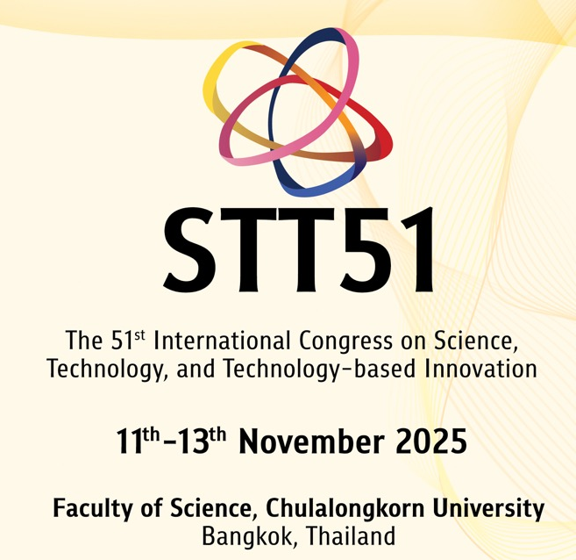
SP7_INV01: PROGRAMMABLE MULTICHANNEL LIGHTING FOR ACCURATE SPECTRAL CONTROL AND DAYLIGHT EMULATION
SP7 - COLOUR SCIENCE/TECHNOLOGY, LIGHT AND APPLICATIONS
Steve Paolini
President, Telelumen LLC
November 12, 2025

Slide 2
Agenda
Introduction
Light sources
Daylight – graphs and pictures including Como and Yosemite
Programmable Luminaires and Control Software
Summary

Slide 3
Steve Paolini
President
Telelumen LLC
Bio: Steve earned a BSEE from Penn State University in 1981 and joined Hewlett Packard, Optoelectronics Division. While at HP he held a variety of engineering and management positions in California, Japan, and Malaysia. In 2000 he joined Lumileds as a founding member. In 2007 he founded Telelumen, where he is currently the President. He was also the CTO at Lunera Lighting and the CTO at NEXT Lighting. He speaks frequently on a variety of topics related to solid state lighting, particularly daylight replication, and holds 25 issued patents.

Slide 4
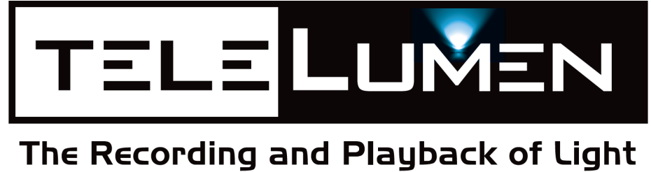
Founded 2007 – Saratoga, CA
Purpose – Replicate any spectral power distribution
Products and services to record and playback light
Products:
Octa (various 8 color light player luminaires)
Dittosizer (24 channel light player luminaire)
Spectraloc – control software
Content – spectrometer recordings, Lumenscripts

Slide 5
Programmable Spectrum Markets
Consumer electronics – cameras, displays, sensors
University and hospital labs – sleep, vision
University and government labs – lighting research
Supply chain – Critical color control

Slide 6
Programmable Spectrum
Telelumen focuses on spectrum and time
Goal is to replicate actual daylight SPD not just CCT
Telelumen focuses on radiometry vs. photometry

Slide 7
What is Daylight?
Circadian, Human Centric, Healthy, but…
A fundamental aspect is the overall experience.
Daylight is complex. The SPD changes with:
time of day
the weather
time of year
place on earth
your immediate environment – window, sidewalk, park, …
It’s processional – sun, shadows move during the day

Slide 8
Daylight Experience
Continuous SPD in the visible spectrum (380 – 780 nm) and beyond
Continuous change with time
Both daylight itself and personal location/gaze
Color temperatures are much higher than typical electric light
Deep red >650nm is critical
Photometrics are not sufficient to represent the daylight experience.
Chromaticity is typically not on the black body or daylight locus
CCT does not define the SPD
When energy use is important efficiency is better metric than efficacy
Optical Watt per Electrical Watt vs. Lumens per Watt

Slide 9
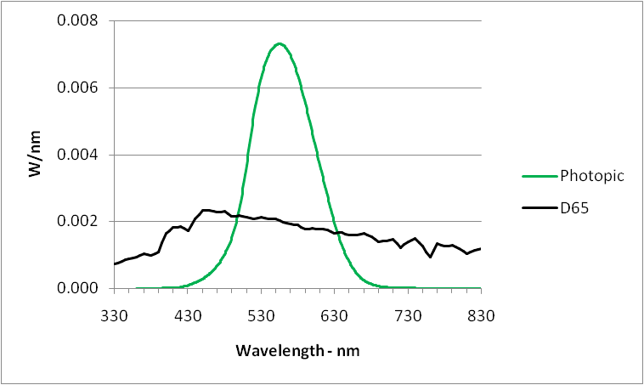
Eye cone response
for “standard observer”
Weighting for lumen
visible
spectrum

Slide 10
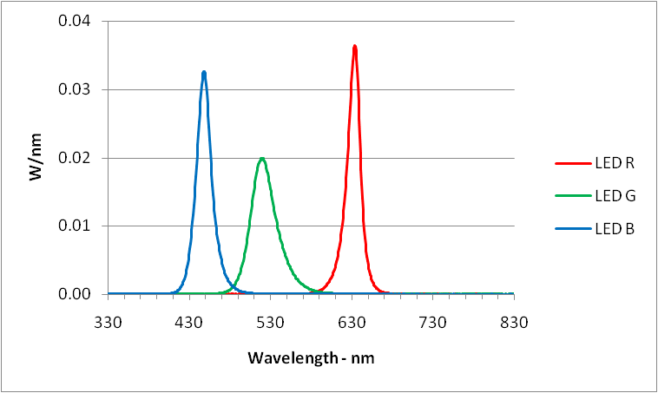
Sparse SPD example
visible
spectrum
Copyright Telelumen LLC 2019 All Rights Reserved

Slide 11
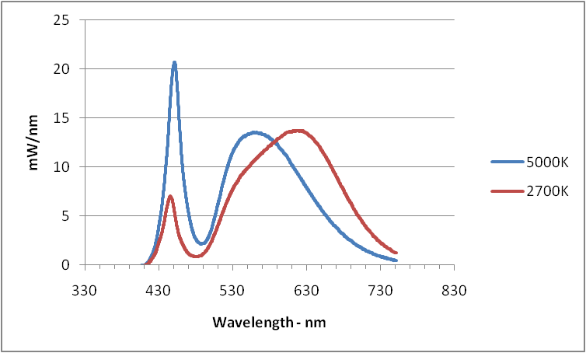
Warm white, cool white example
visible
spectrum
Copyright Telelumen LLC 2019 All Rights Reserved

Slide 12
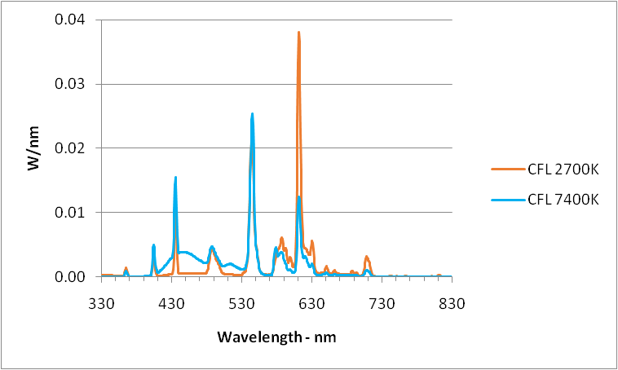
Sparse SPD example
visible
spectrum
Copyright Telelumen LLC 2019 All Rights Reserved

Slide 13
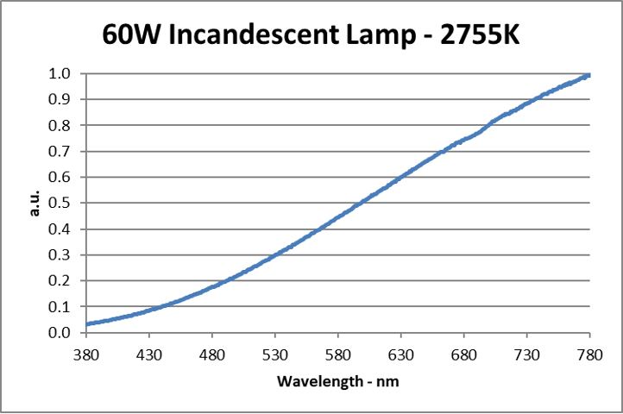

Slide 14
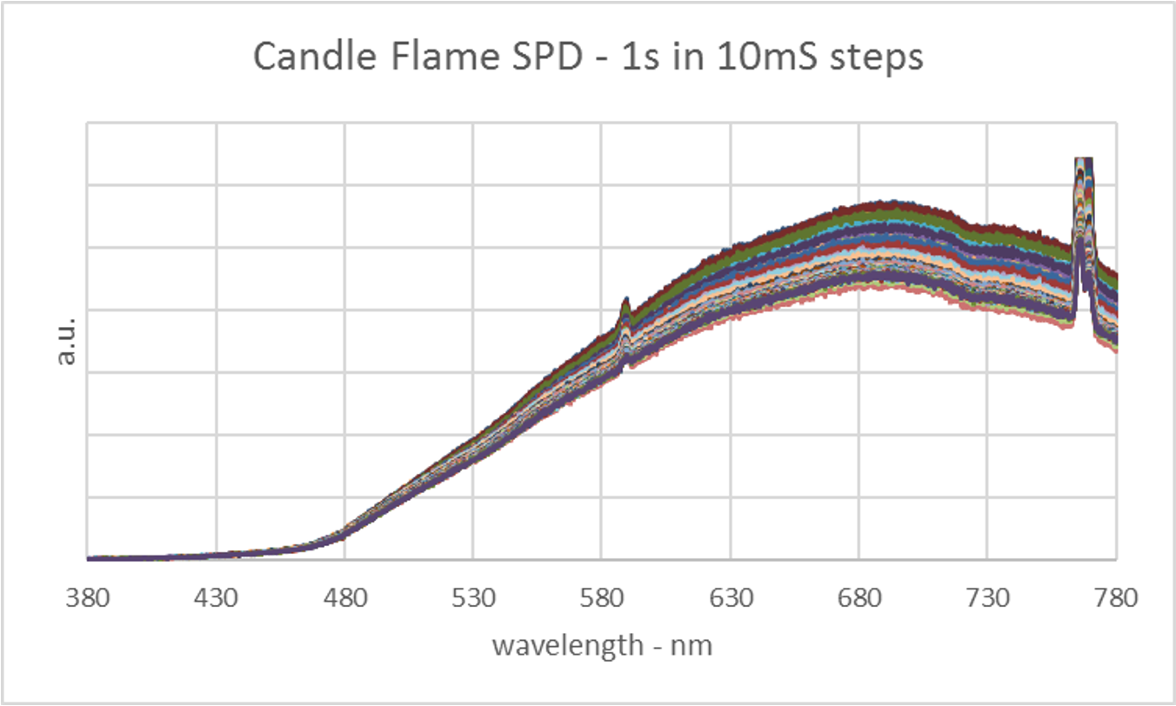

Slide 15
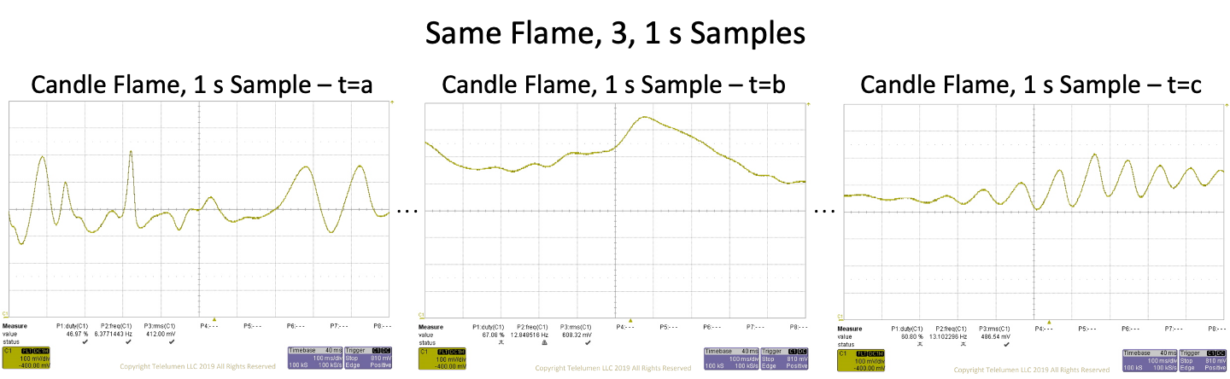

Slide 16
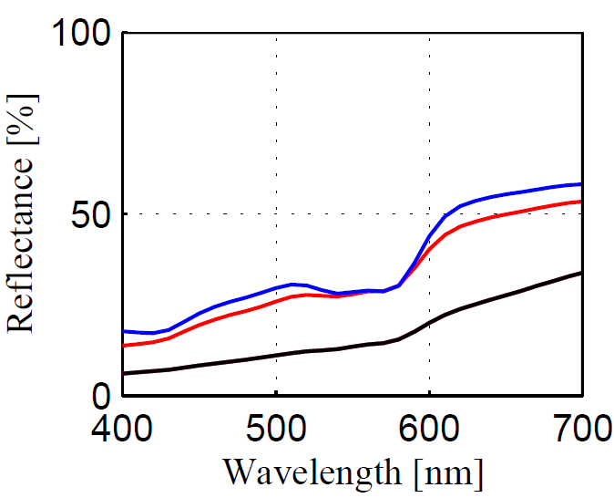
Deep Red is Key to Proper Skin Rendition
About half the response is >600nm
Caucasian
Asian
African
© 2002 Oulu University Library
From: ”Face colour under varying illumination”, Chapter. 4; http://herkules.oulu.fi/isbn9514267885/html/i1030756.html

Slide 17
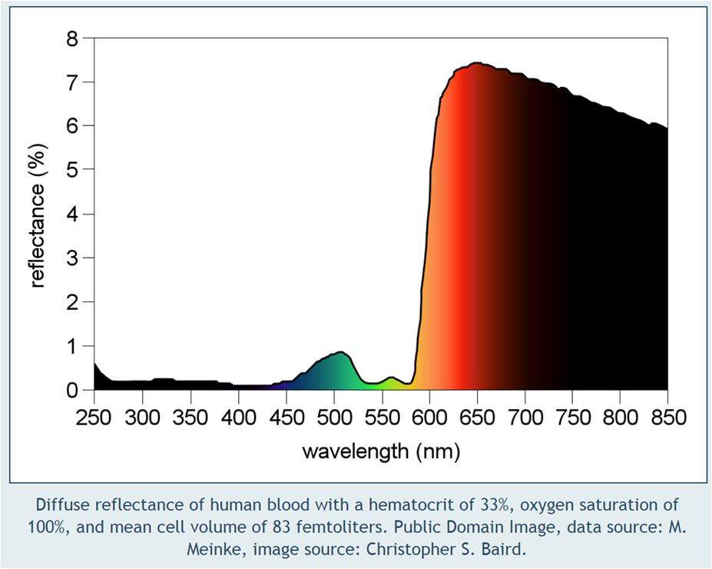

Slide 18
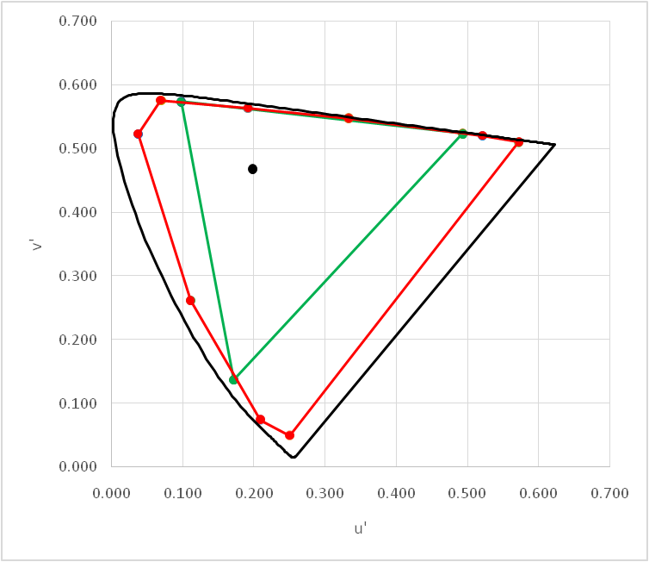
OLED Display vs. “Continuous” Luminaire

Slide 19
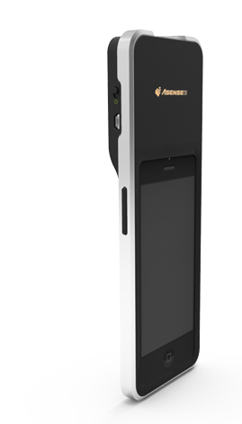
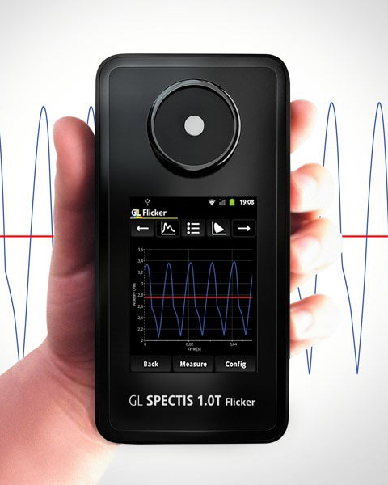
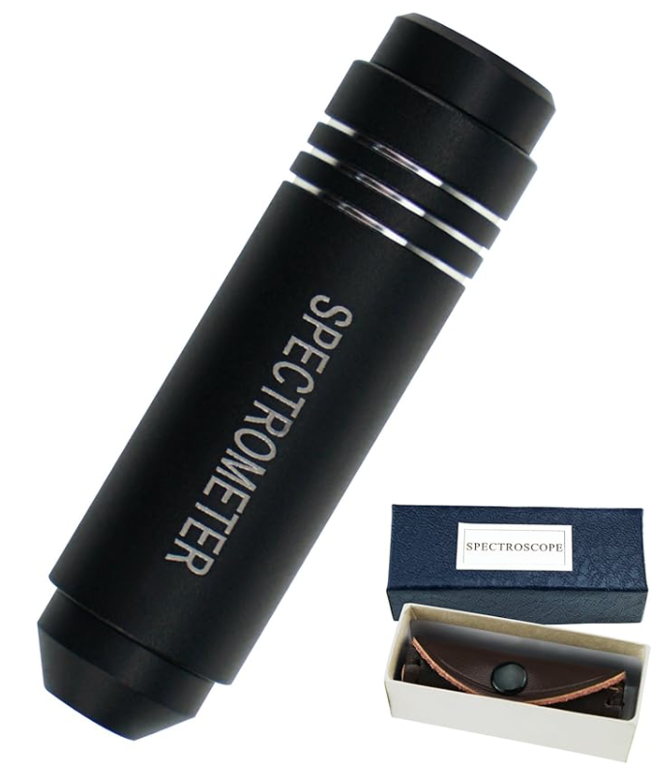
Handheld Spectrometer examples

Slide 20
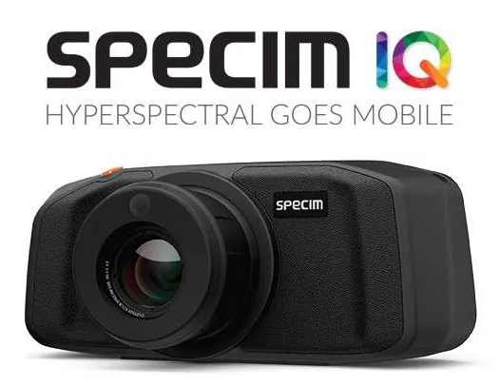
Latest Addition – Future Recordings

Slide 21
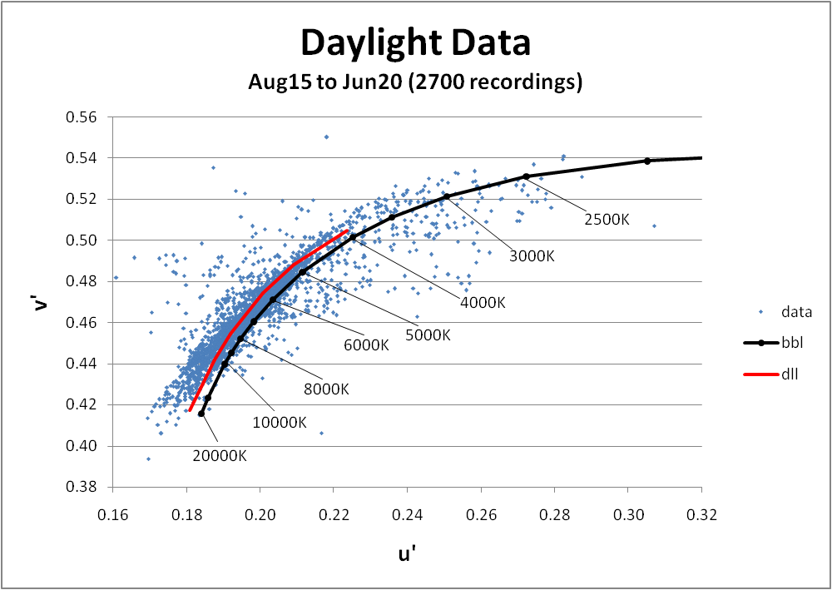
F27--
2700 Daylight Recordings
D65
highly variable, high CCT, even near sunrise/set

Slide 22
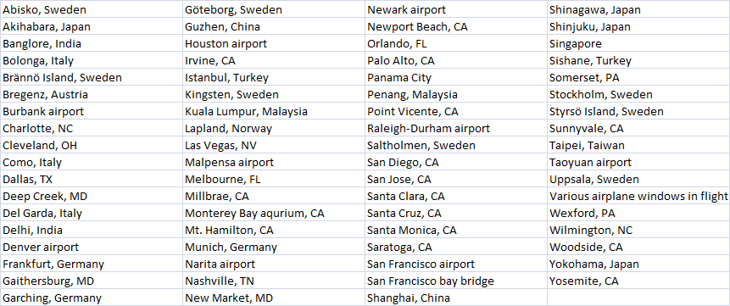
Sample of Recording Locations

Slide 23
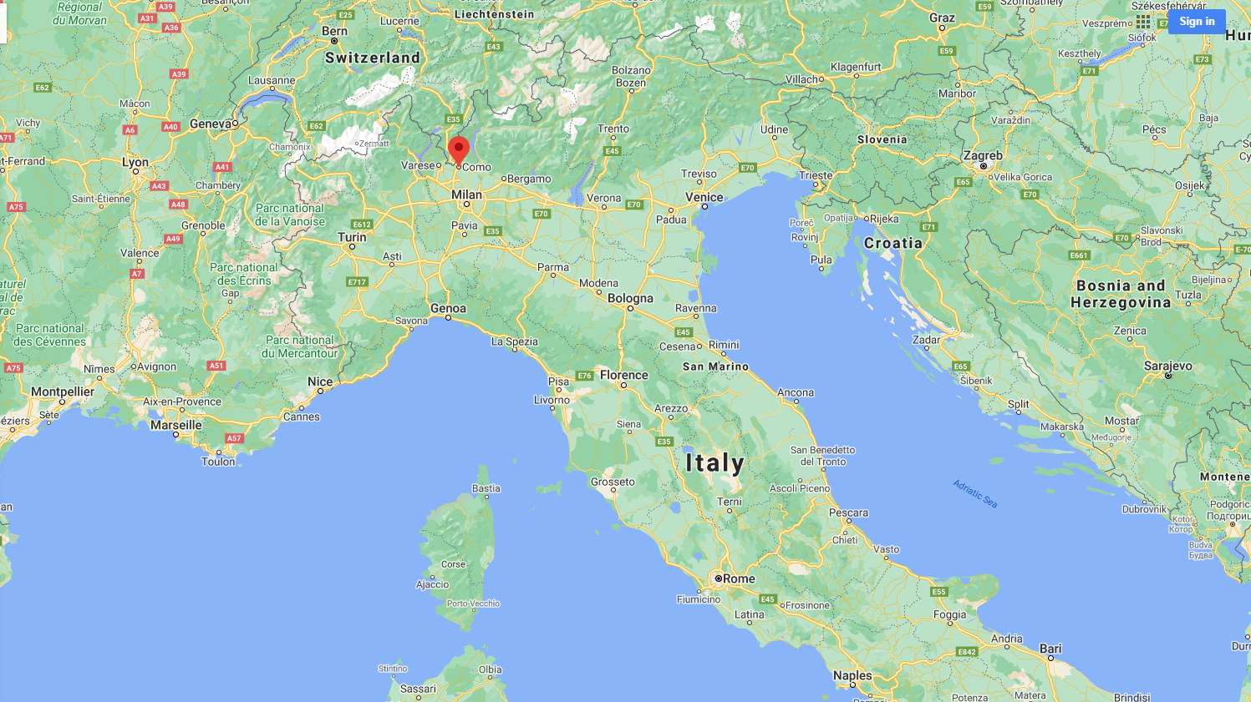

Slide 24
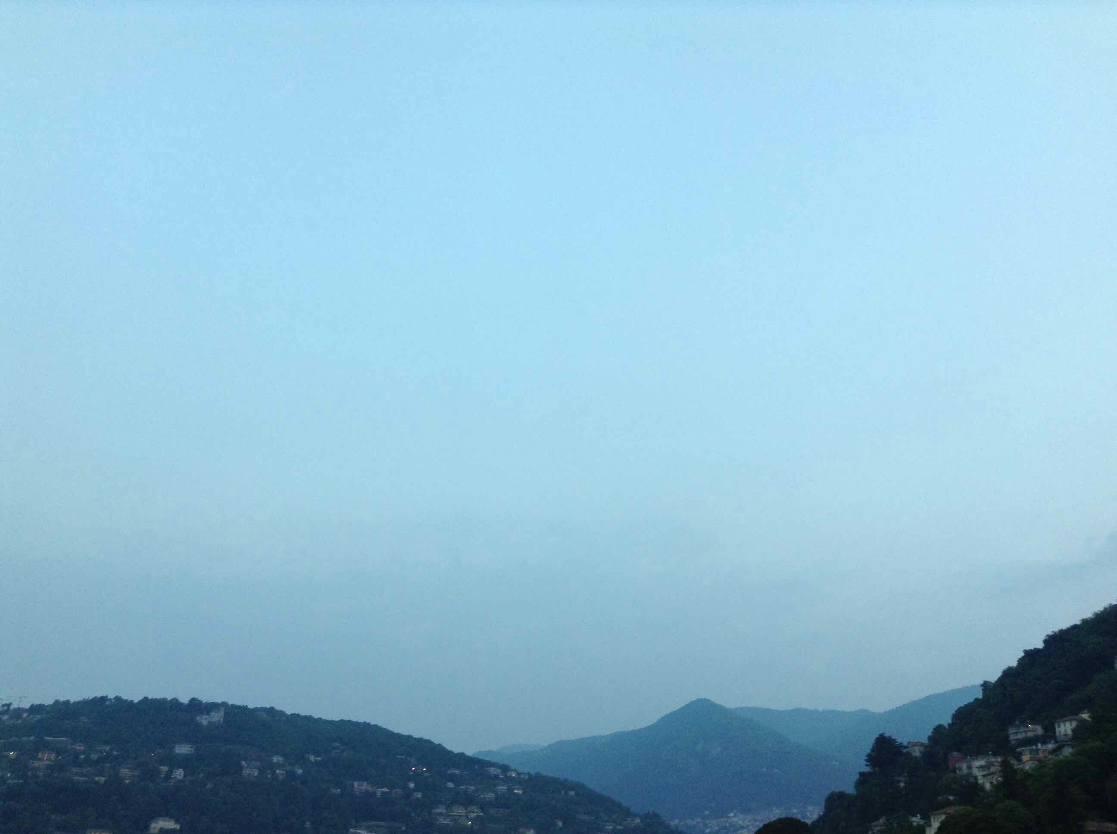
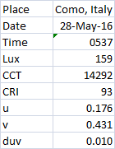
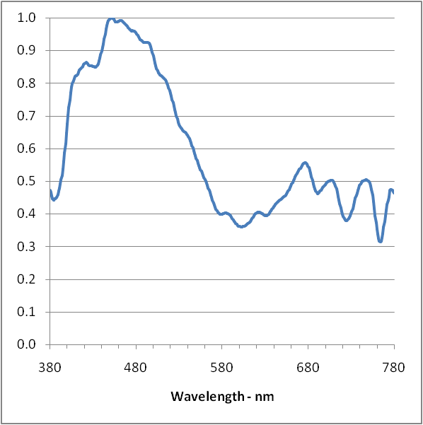
Copyright Telelumen LLC 2019 All Rights Reserved

Slide 25
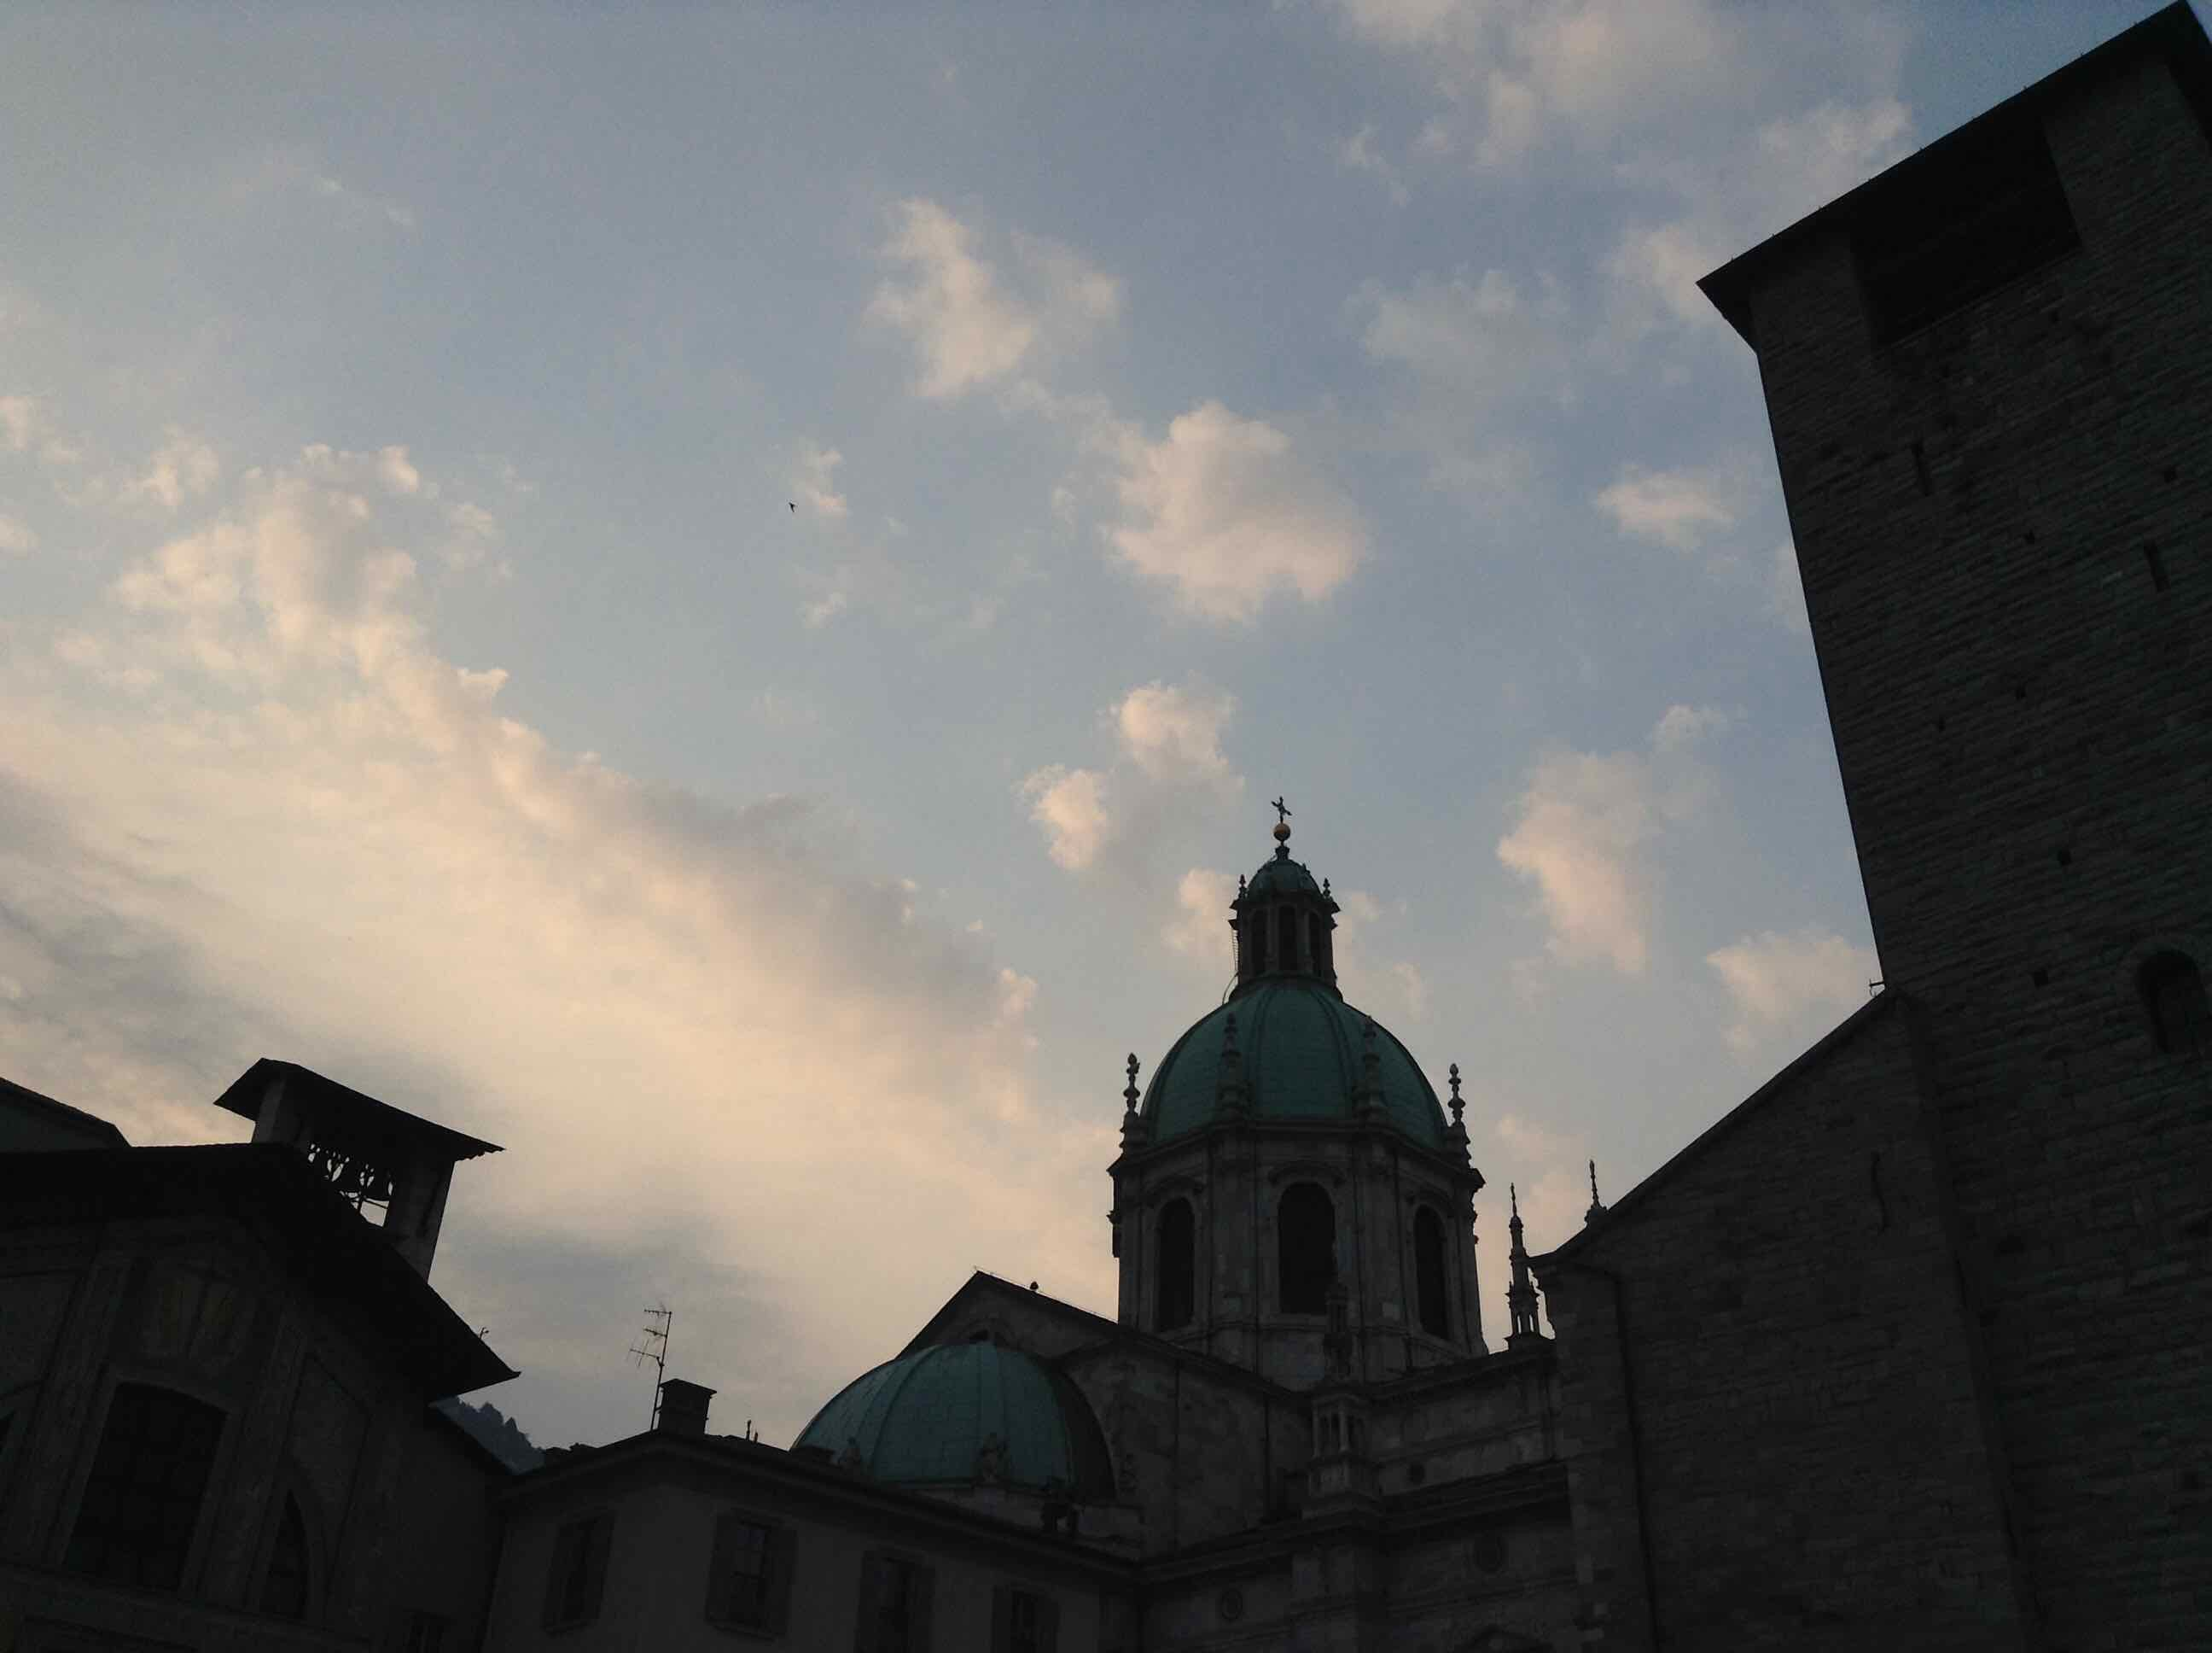
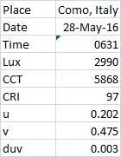
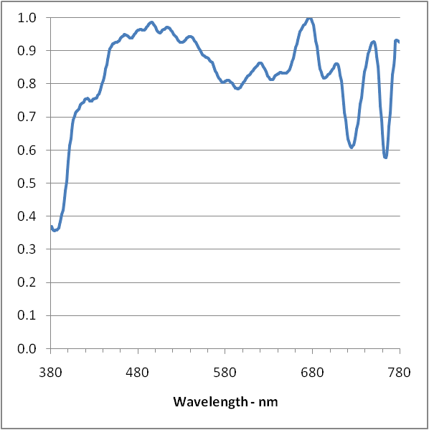
Copyright Telelumen LLC 2019 All Rights Reserved

Slide 26
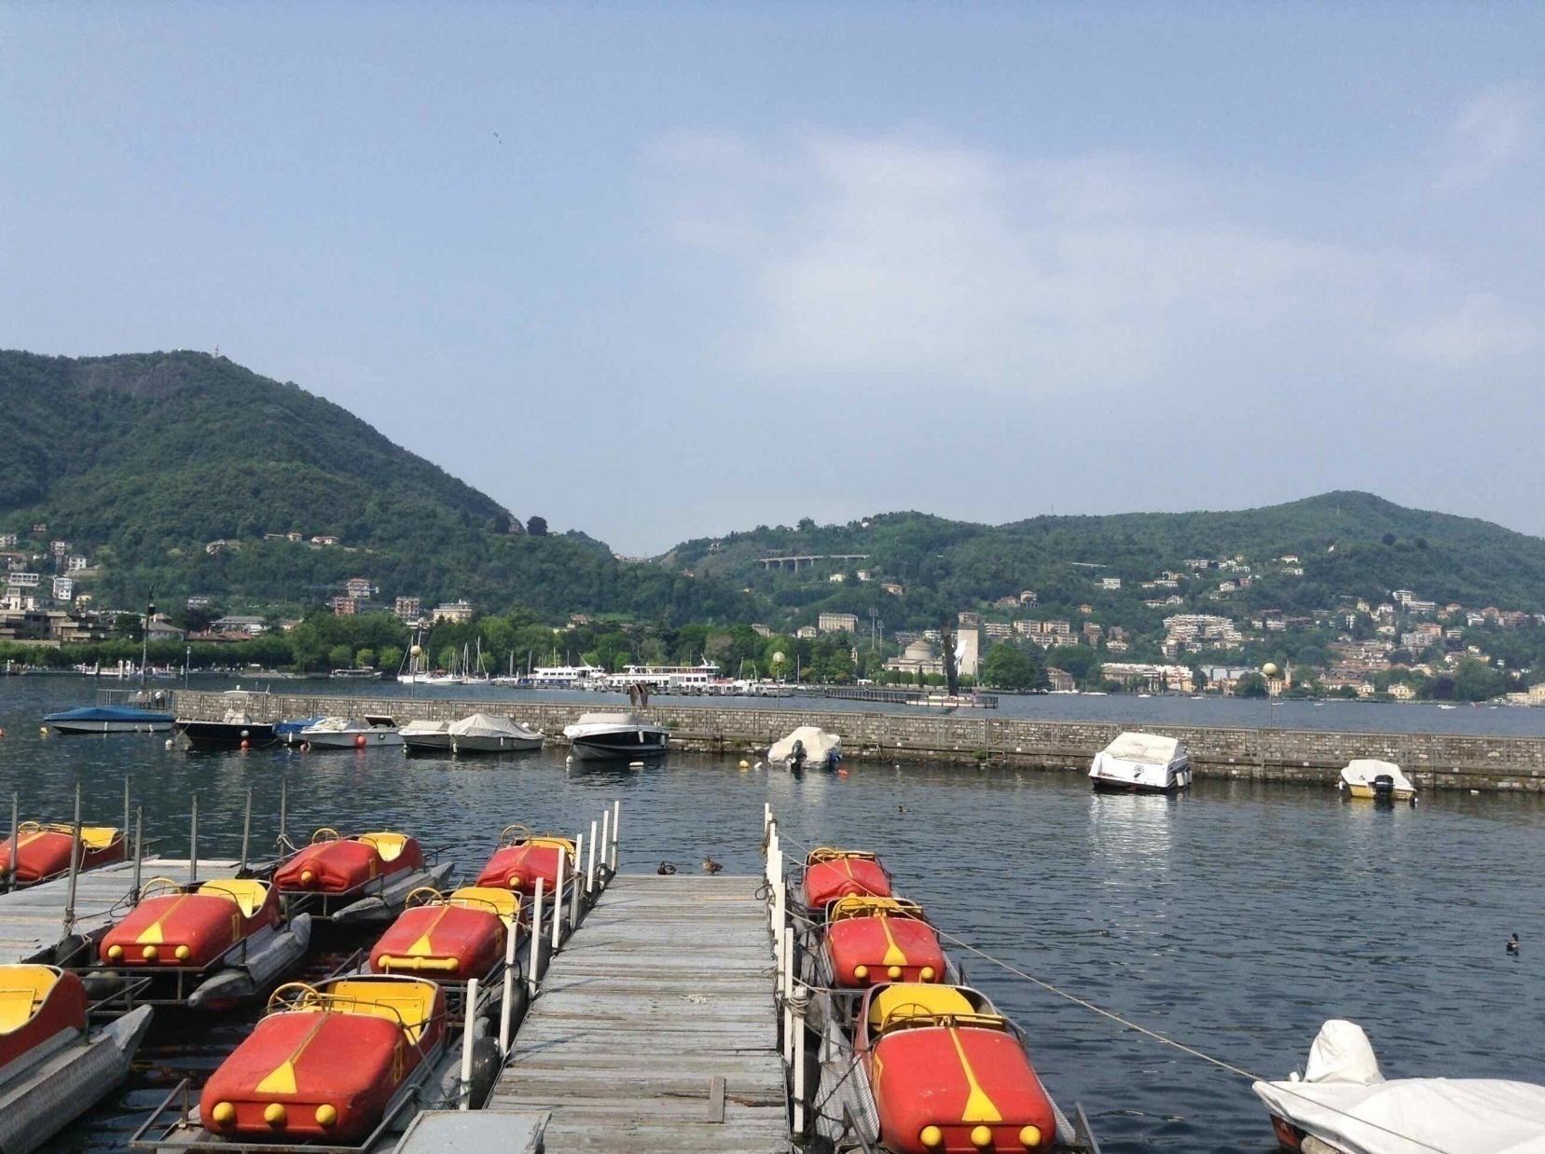
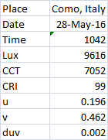
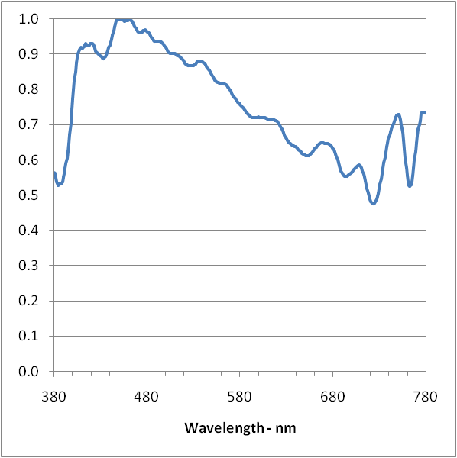
Copyright Telelumen LLC 2019 All Rights Reserved

Slide 27
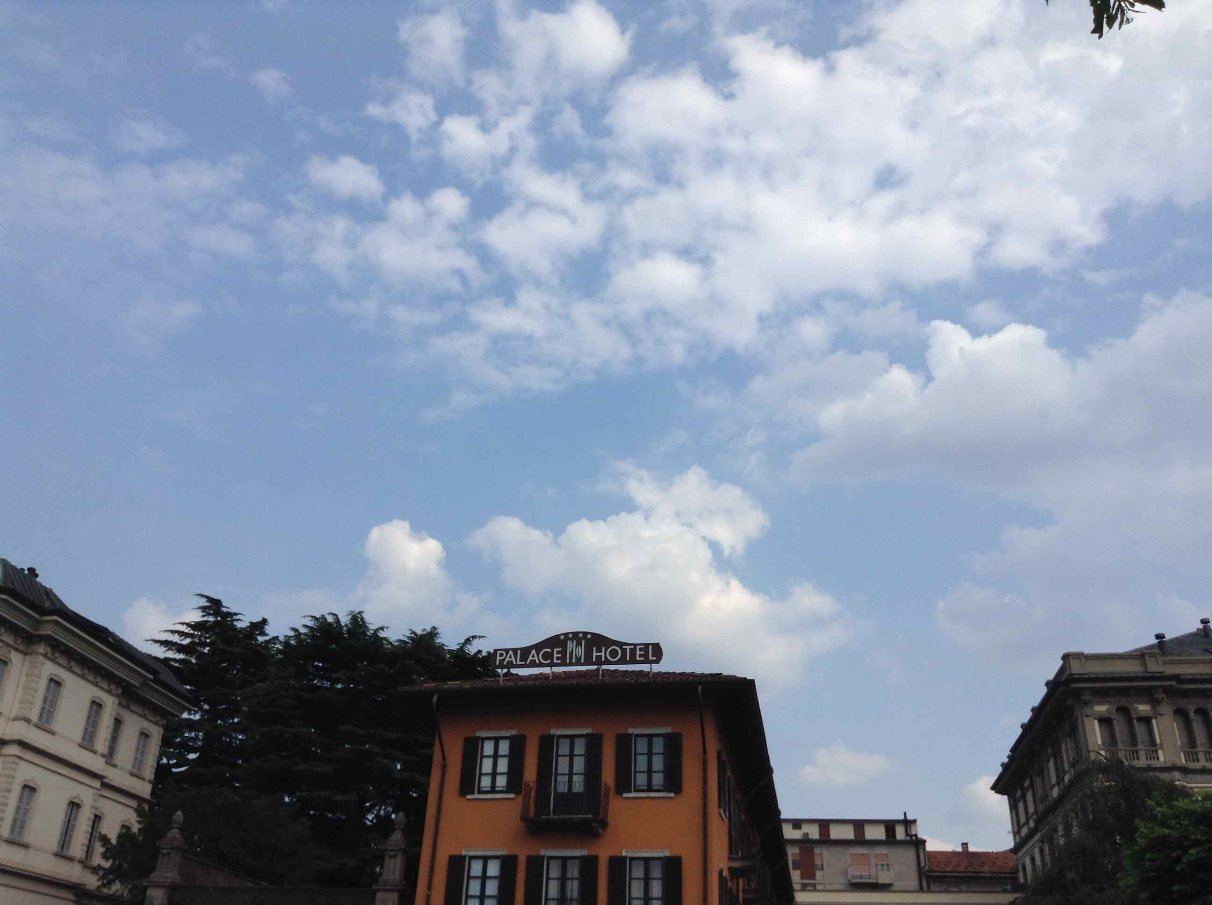
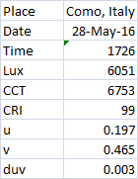
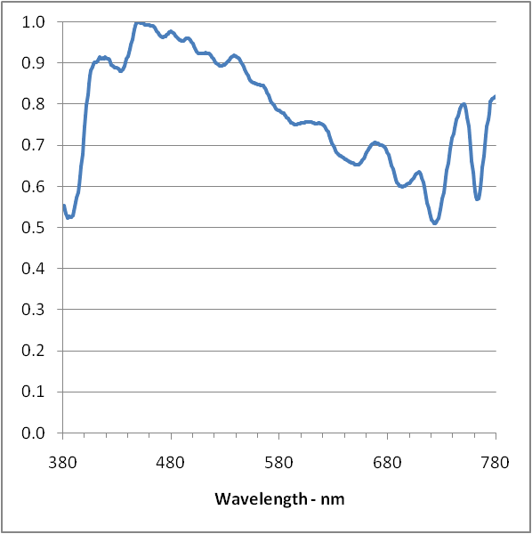
Copyright Telelumen LLC 2019 All Rights Reserved

Slide 28
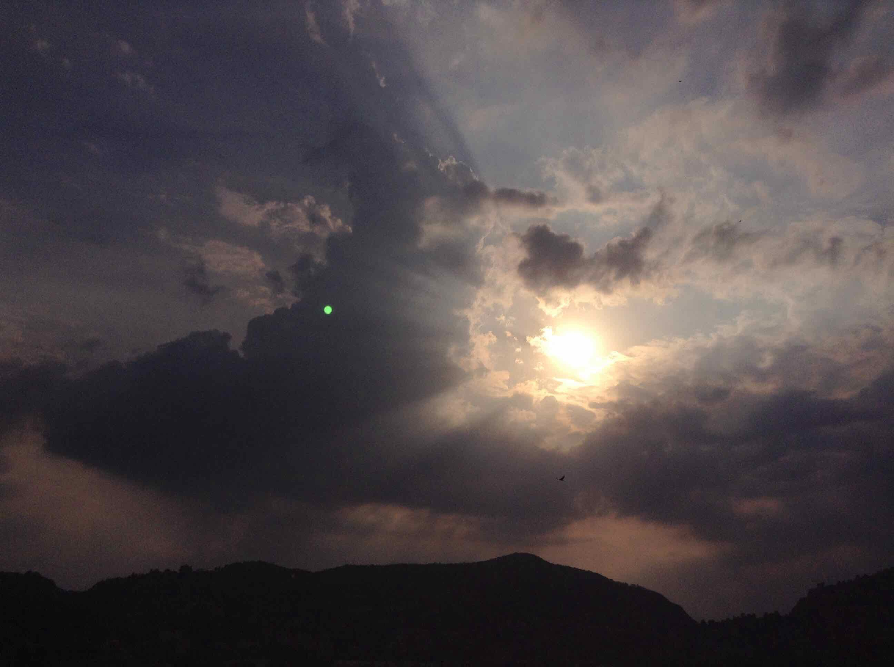
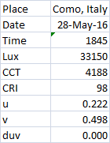
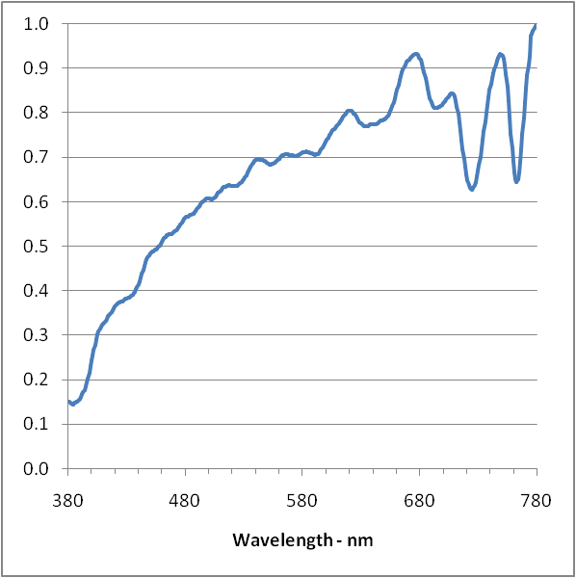
Copyright Telelumen LLC 2019 All Rights Reserved

Slide 29
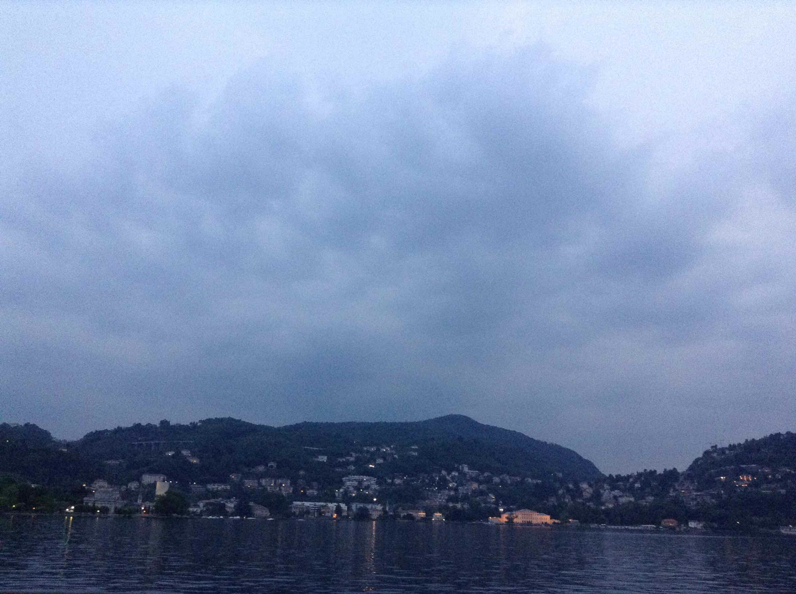
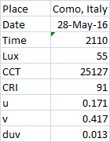
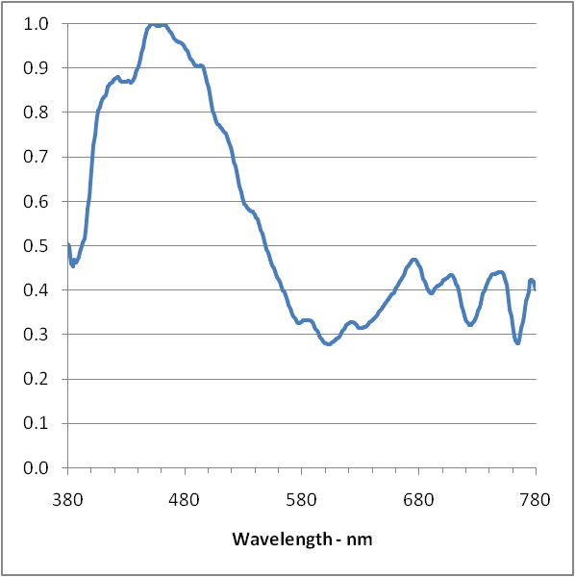
Copyright Telelumen LLC 2019 All Rights Reserved

Slide 30
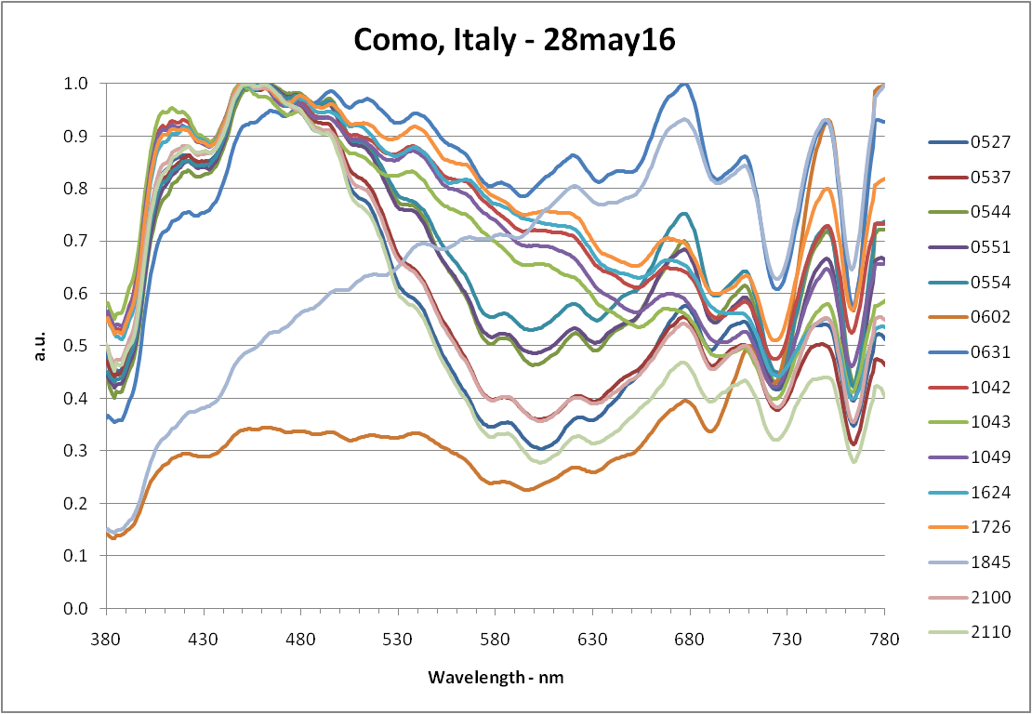
Copyright Telelumen LLC 2019 All Rights Reserved

Slide 31
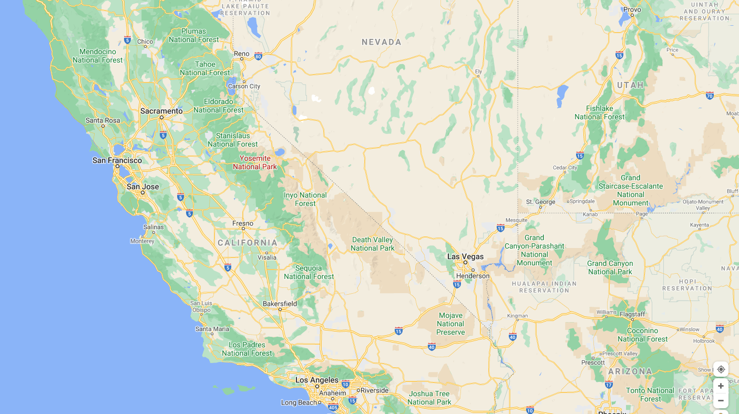

Slide 32
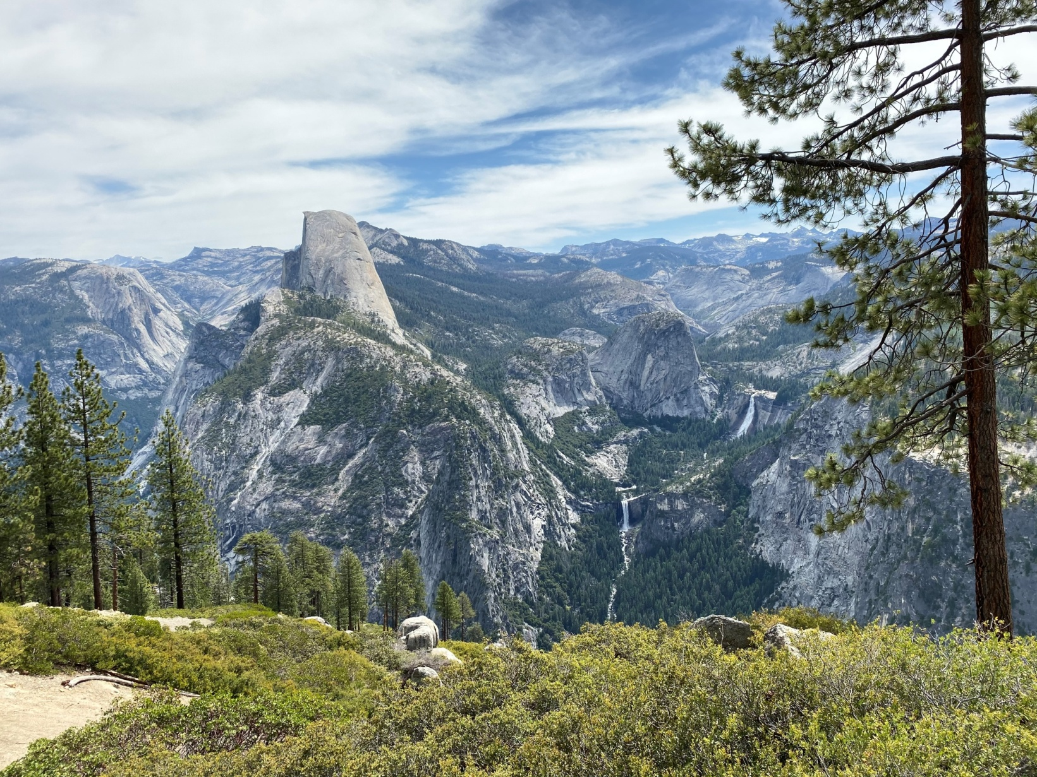
Yosemite National Park,
California
14jun20
Diving Board – aka The Beak
Half Dome
Liberty Cap
Nevada Falls
Vernal Falls
Start/Finish – Curry Village
Copyright Telelumen LLC 2020 All Rights Reserved

Slide 33
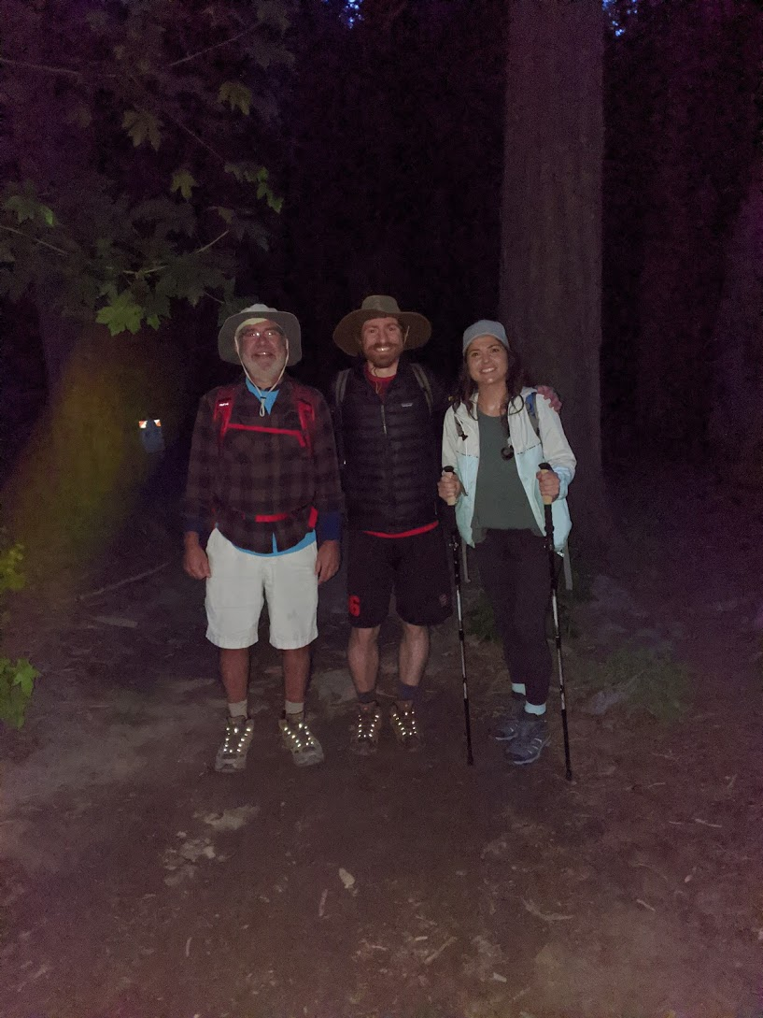
June 14, 2020
0503 – The hike begins.
Copyright Telelumen LLC 2020 All Rights Reserved

Slide 34
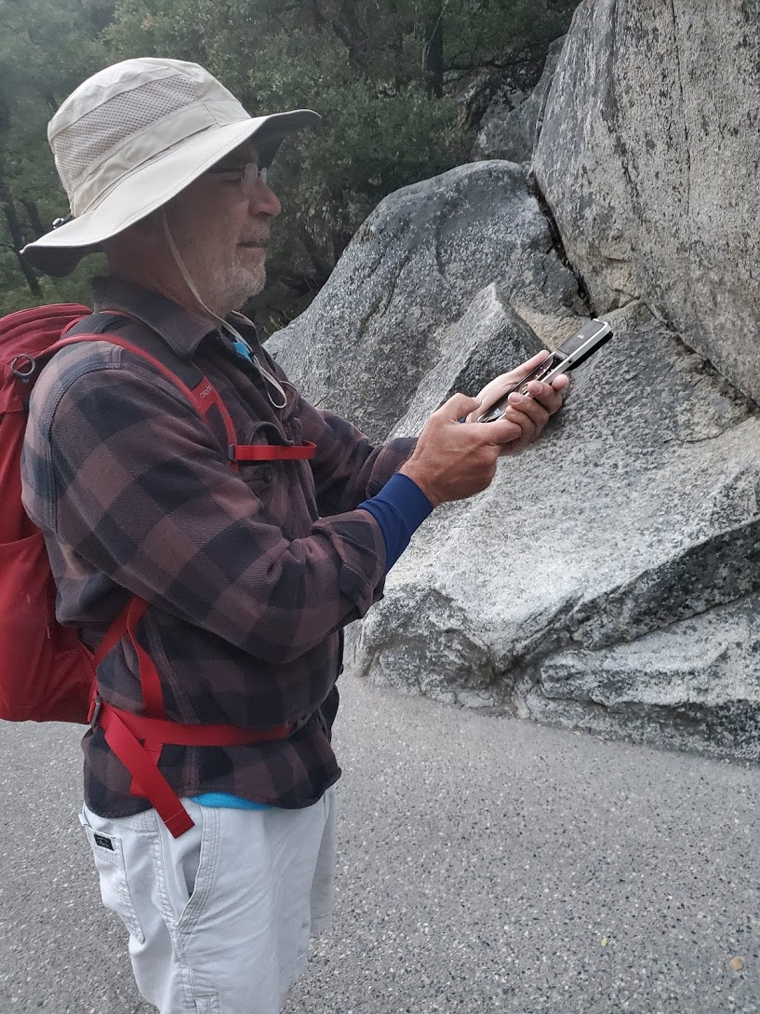
0526 – Typical recording posture.
Lighting Passport Spectrometer
Copyright Telelumen LLC 2020 All Rights Reserved

Slide 35
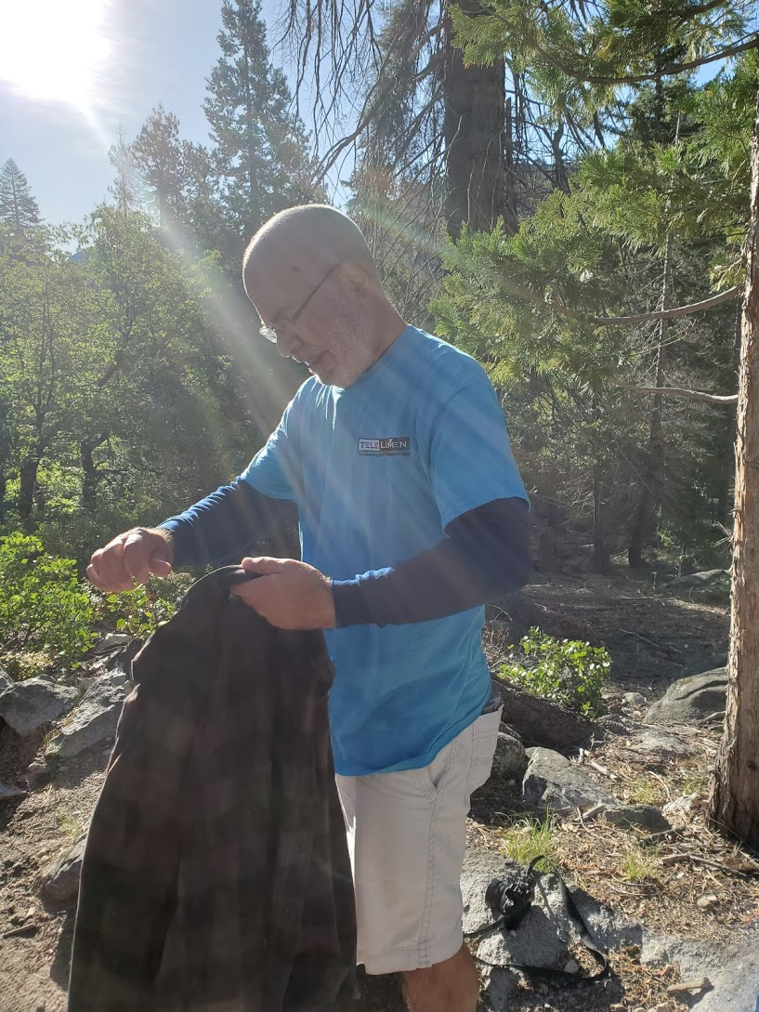
0728 – Day is heating up.
Copyright Telelumen LLC 2020 All Rights Reserved

Slide 36
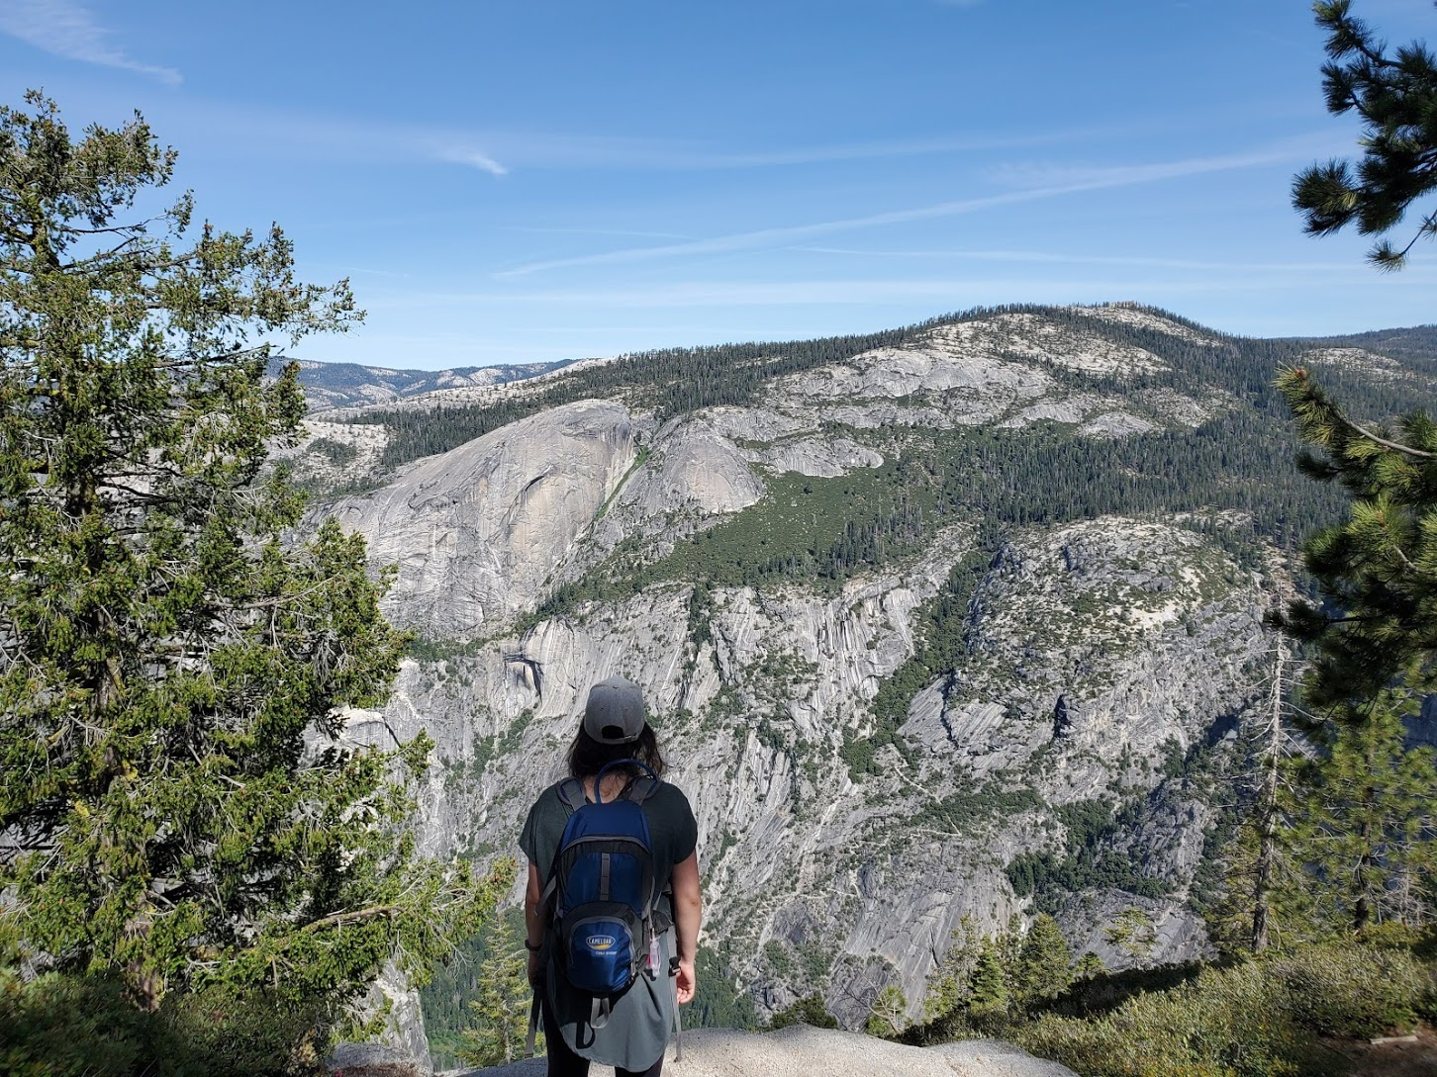
0944 – Taking it in.
Copyright Telelumen LLC 2020 All Rights Reserved

Slide 37
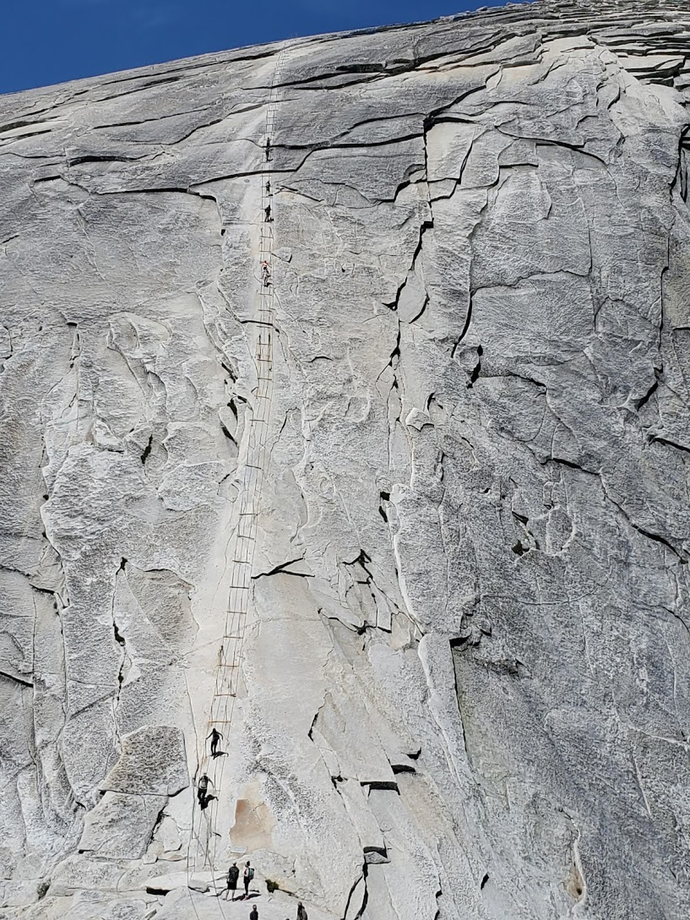
1051 – Need to gather courage.
Copyright Telelumen LLC 2020 All Rights Reserved

Slide 38
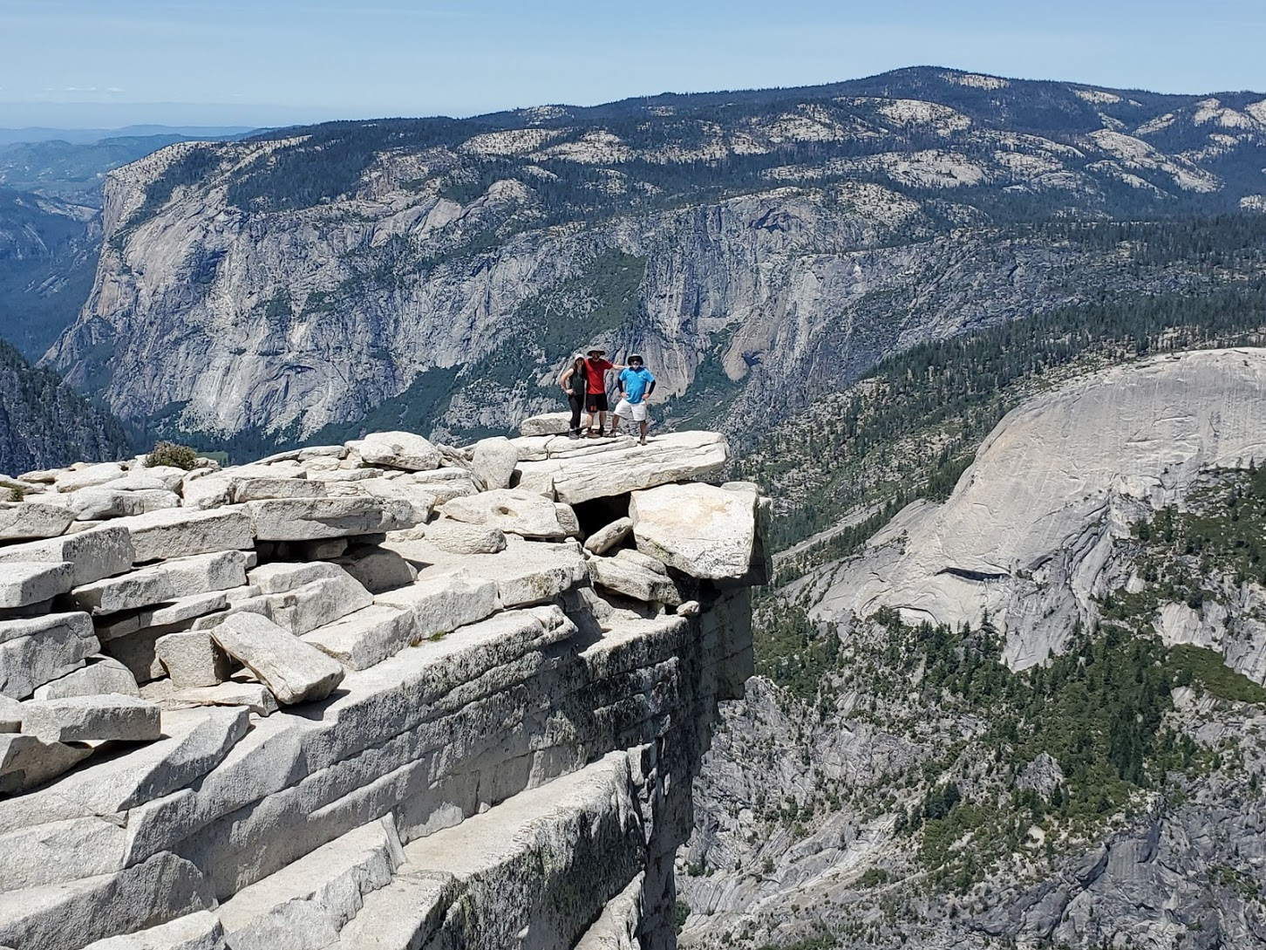
1054 – Out on the beak.
Copyright Telelumen LLC 2020 All Rights Reserved

Slide 39
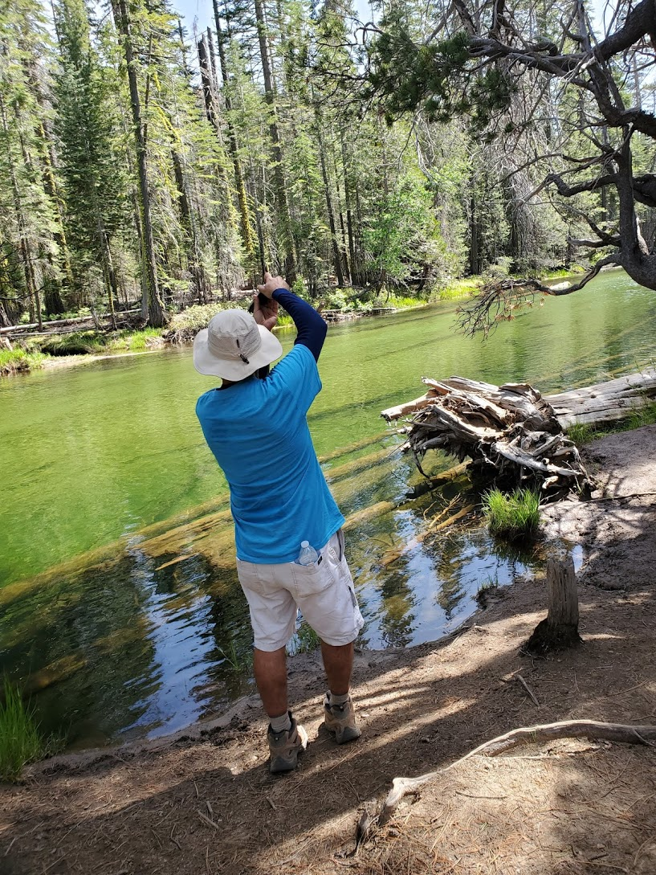
1529 – Measuring clear green water.
Copyright Telelumen LLC 2020 All Rights Reserved

Slide 40
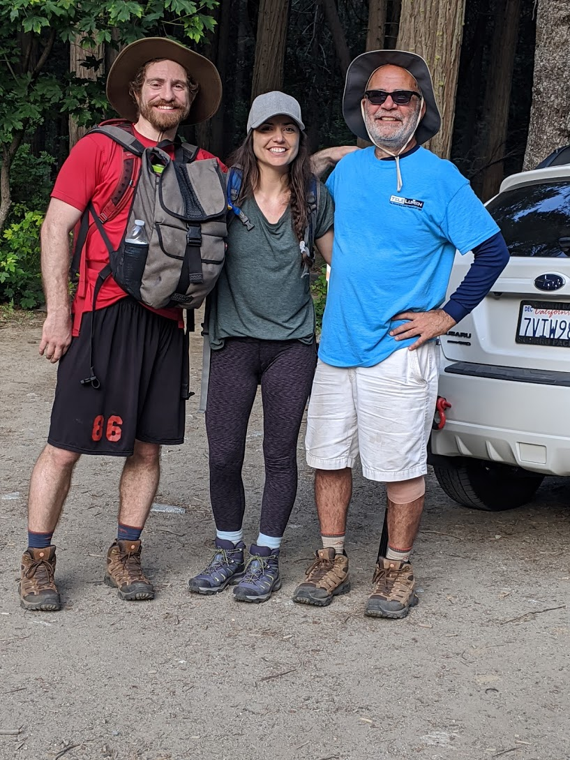
1915 – Back where we started.
Copyright Telelumen LLC 2020 All Rights Reserved

Slide 41
By the numbers
Starting elevation – 4,000 feet (1,200 m)
Ending elevation – 8,800 feet (2,700 m)
According to Fitbit:
45,000 steps
19 miles (30 km)
4,910 calories burned
Weather: low 50 F – high 77 F (10 C – 25 C)
Total time: 14 hours 15 mins

Slide 42
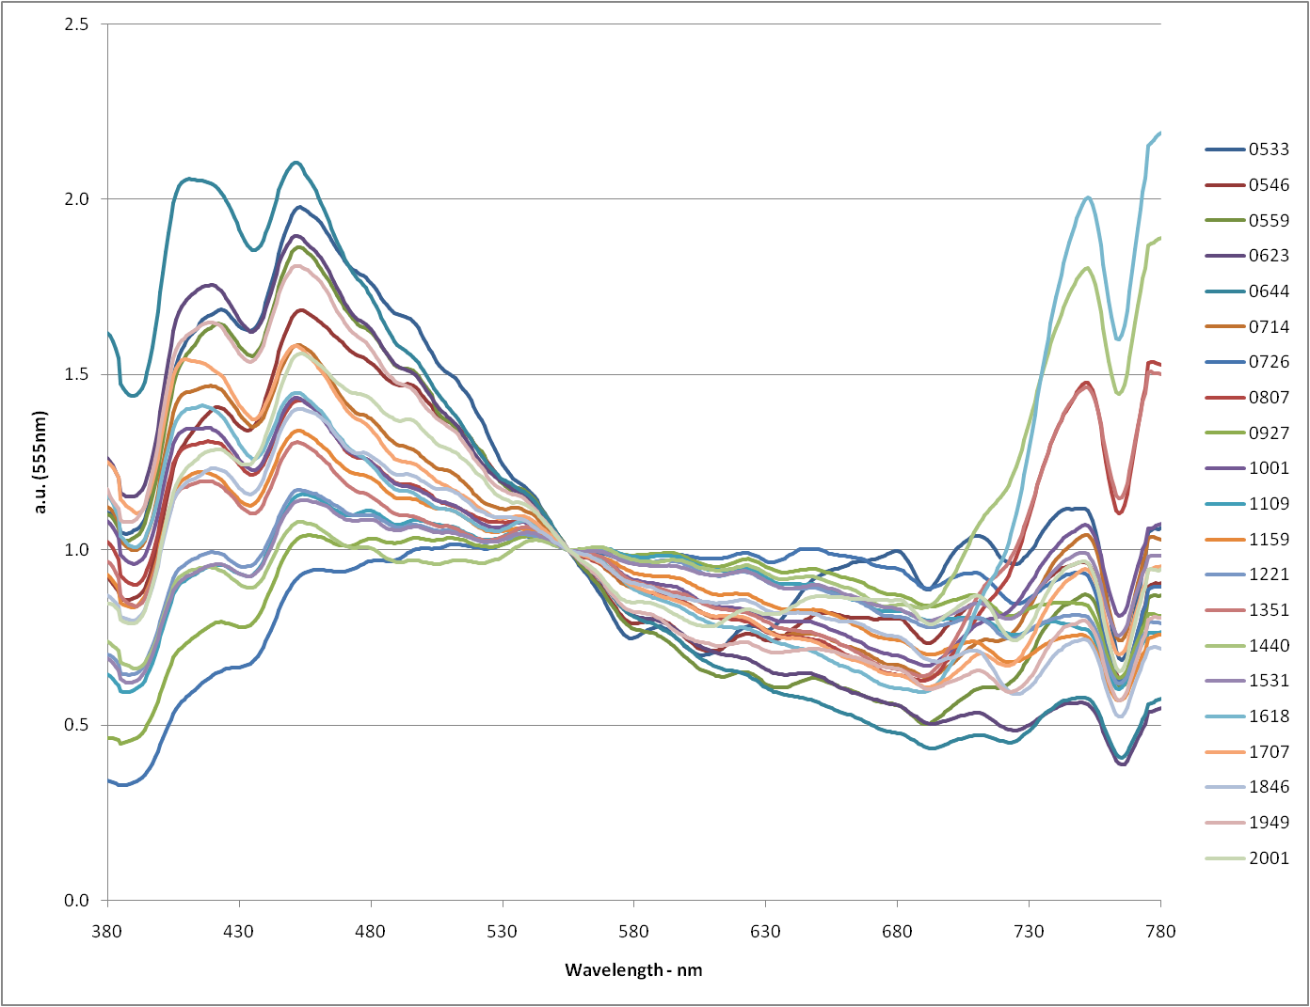
Yosemite National Park, Half Dome Hike, 14jun20

Slide 43
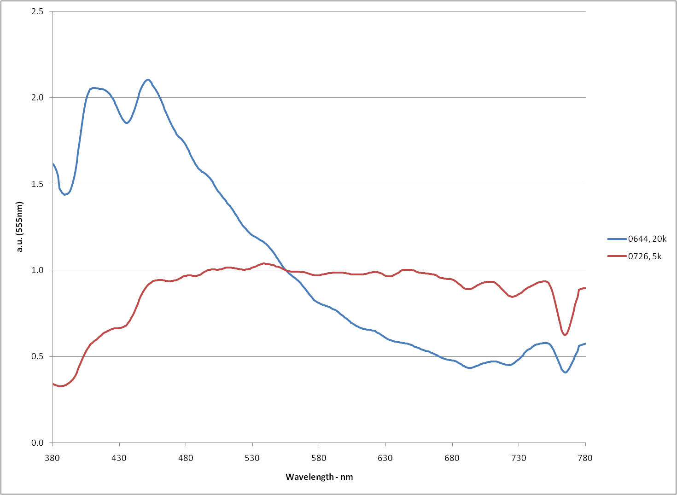
Max, Min CCT – 14jun20

Slide 44

21,600K, 0644
Copyright Telelumen LLC 2020 All Rights Reserved

Slide 45

5,100K, 0726
Copyright Telelumen LLC 2020 All Rights Reserved

Slide 46


Santorini, Greece – 29jun25

Slide 47
Day of sunlight
Illuminance sensor pointed up at a mostly blue sky in Saratoga, California
Starts: 28JUN18 at 05:48 Ends: 28JUN18 at 20:48
Lux range in actual recording: 10,000:1
Color temperature range: 5,700K to 70,000K

Slide 48


Copyright Telelumen LLC 2019 All Rights Reserved

Slide 49

Copyright Telelumen LLC 2019 All Rights Reserved

Slide 50

Copyright Telelumen LLC 2019 All Rights Reserved

Slide 51



Copyright Telelumen LLC 2019 All Rights Reserved

Slide 52



Copyright Telelumen LLC 2019 All Rights Reserved

Slide 53

Saratoga morning sky, 7:11AM, 24jan18
Copyright Telelumen LLC 2019 All Rights Reserved

Slide 54


Copyright Telelumen LLC 2019 All Rights Reserved

Slide 55

Cleveland evening sky, 18:53PM, 19oct17
Copyright Telelumen LLC 2019 All Rights Reserved

Slide 56


Copyright Telelumen LLC 2019 All Rights Reserved

Slide 57


Beautiful high CCT daylight with non-standard SPD.
7526K, 300 lux
13nov15
Telelumen LLC, copyright 2021 all rights reserved

Slide 58

Efficiency vs. Wavelength
Including mixing optics.
Not including power supply and driver.

Slide 59

Photon Energy and Vf vs. Wavelength

Slide 60


Rf (Color Quality), CCT, and # of colors
Fire
Daylight
Copyright Telelumen LLC 2023 All Rights Reserved

Slide 61

Spectrally Tunable Architecture

Slide 62

Spectraloc Control Software

Slide 63


24-channel
8-channel
2755K Incandescent Target

Slide 64


Slide 65




24-channel
8-channel
Daylight Recorded at 1712, 18440K
24-channel
8-channel
Daylight Recorded at 1714, 6657K

Slide 66

Octa Light Players 20000K to 1500K

Slide 67

Shown above left are Telelumen Octa Light Players set to a mode enriched in short wavelengths and above right is the same system enriched in long wavelengths at an intensive care unit (ICU) in the Jefferson Hospital for Neuroscience in Philadelphia, PA (2019).

Slide 68

Claude Monet – “Haystacks” The series shows differences in perception of light across various times of day, seasons, and types of weather.
http://en.wikipedia.org/wiki/Haystacks_(Monet)

Slide 69
Summary
Daylight is the gold standard for lighting.
Daylight is complex – continuous spectrum, changing over time.
Daylight locus is only occasionally representative of daylight.
Daylight CCTs are much higher than most electric lights.
Typically, even at sunrise and sunset.
Programmable spectrum sources allow many solutions for the same CCT.
Deep red (>650nm) is essential for high CCT acceptance and skin color.
Focus on radiometry, photometry is not sufficient for daylight.

Slide 70
SP7 - COLOUR SCIENCE/TECHNOLOGY, LIGHT AND APPLICATIONS
Questions, Comments
steve@telelumen.com

